Slide 1
Mini Project 3 Gomoku AI
Environment Settings Tutorial

Slide 2
Introduction
This tutorial shows how to install required software to compile and execute this project
There are also some troubleshooting steps
Tutorial for Windows and Mac are both included

Slide 3
For All Students
Please do not use IDEs to compile and run this project
Code Blocks, Dev-C++, Visual Studio, Xcode
Please use command line interfaces to compile and run this project
Cmd, PowerShell, Terminal
You can use anything to write your code
We recommend VSCode

Slide 4
For Windows Users

Slide 5
For Windows Users
Install mingw-w64
Compile your code
Execute your code
Troubleshooting

Slide 6
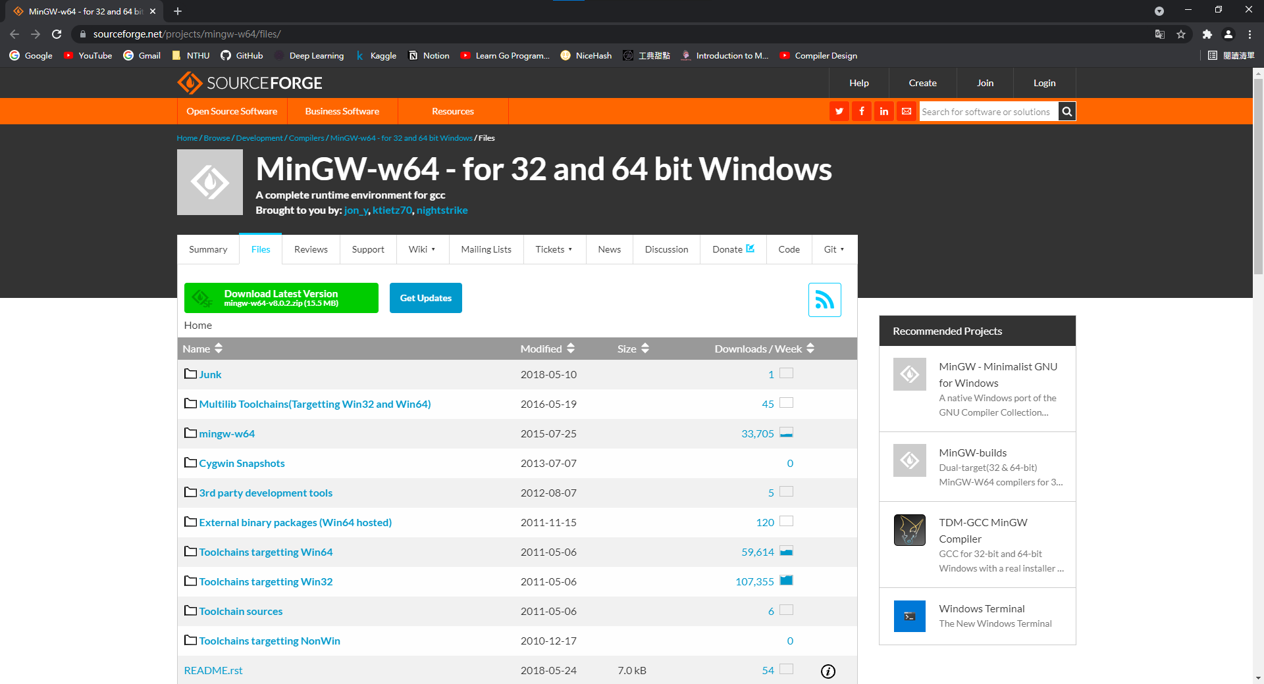
Go to MinGW-W64 Download Page

Slide 7
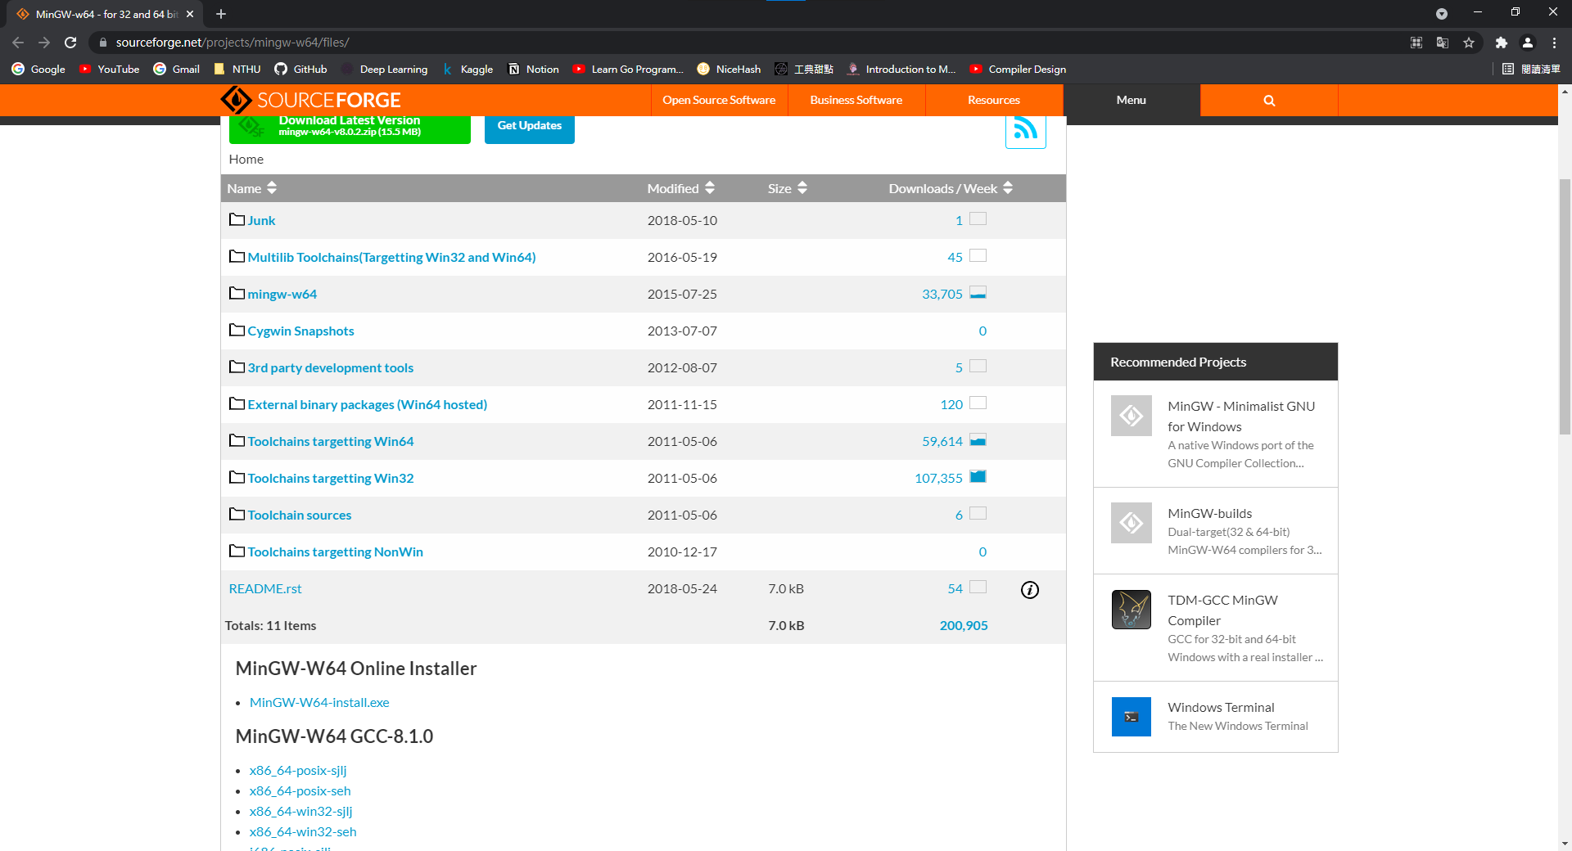
Download MinGW-W64 Online Installer

Slide 8
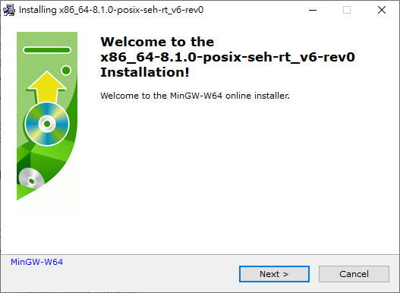
Start the installer, click next

Slide 9
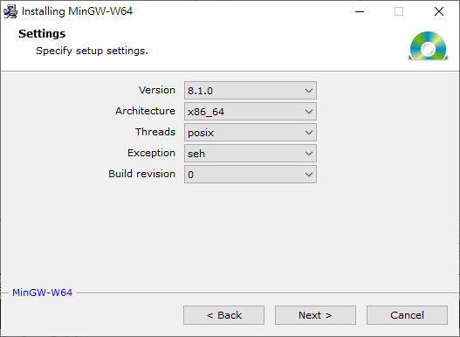
Pick right options according to the screenshot

Slide 10
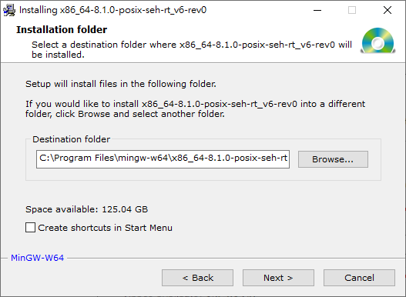
Make sure you remember the install path

Slide 11
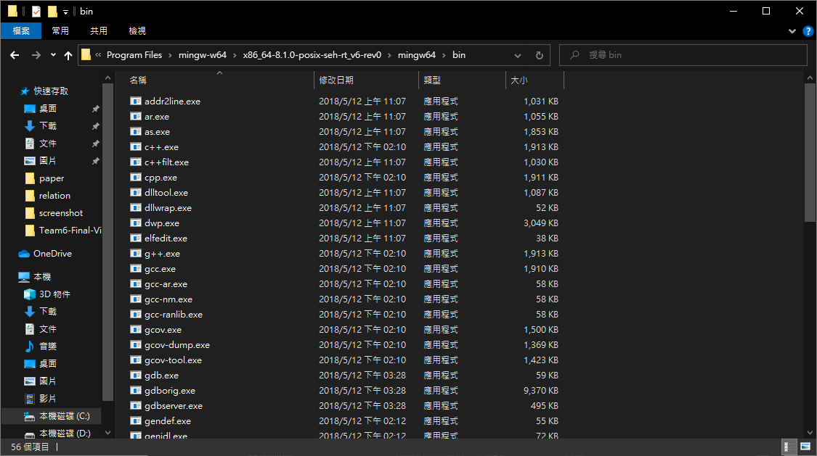
Go to “[install_path]/mingw64/bin”

Slide 12
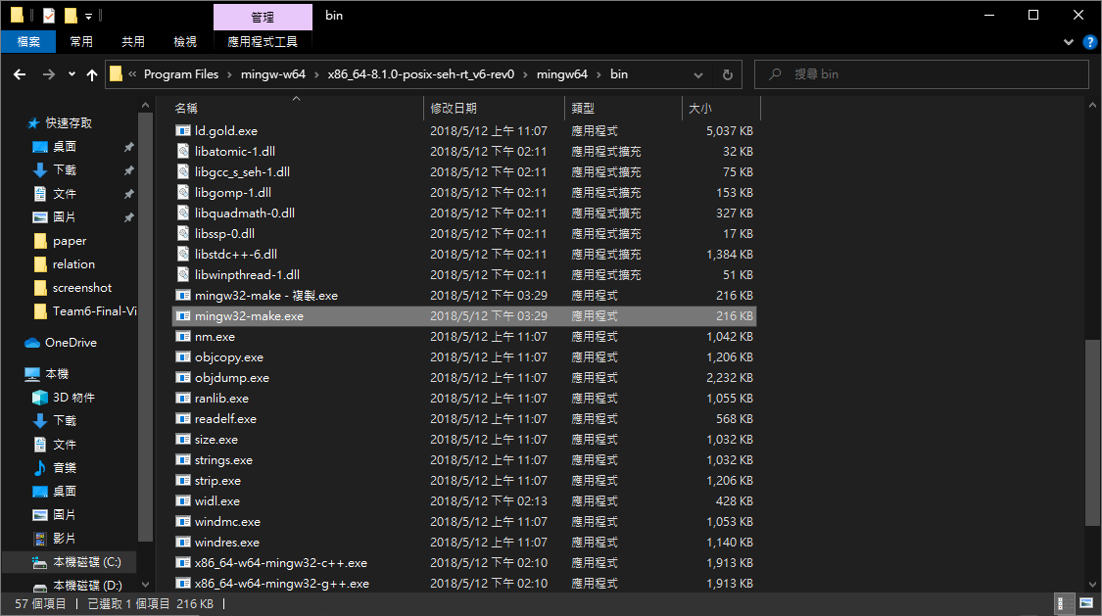
Find “mingw32-make.exe” and copy it

Slide 13
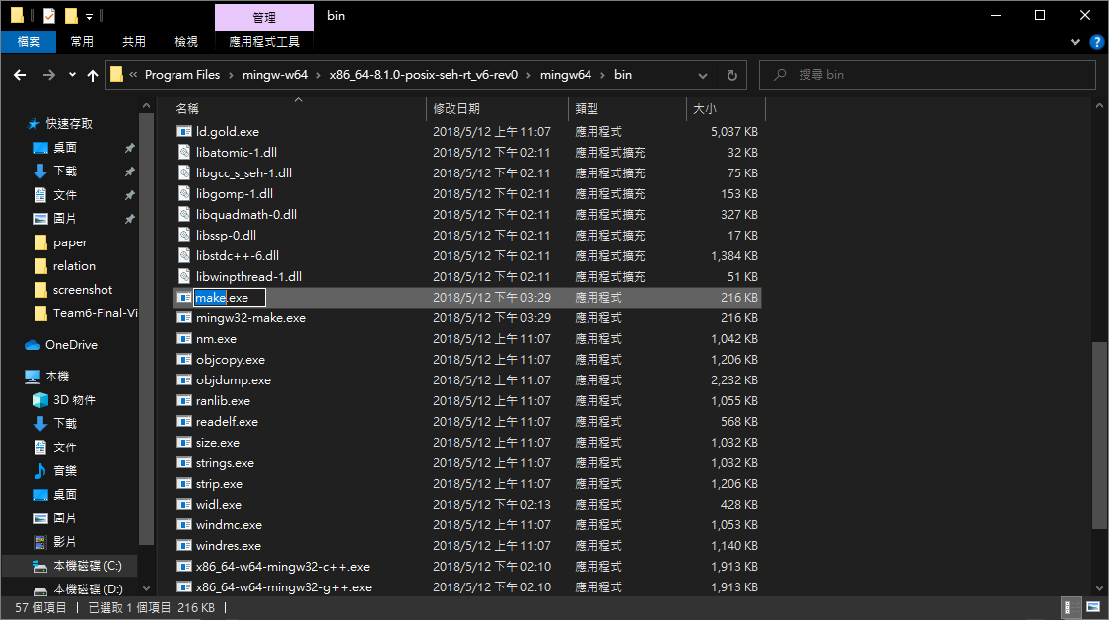
Rename the copied file to “make.exe”

Slide 14
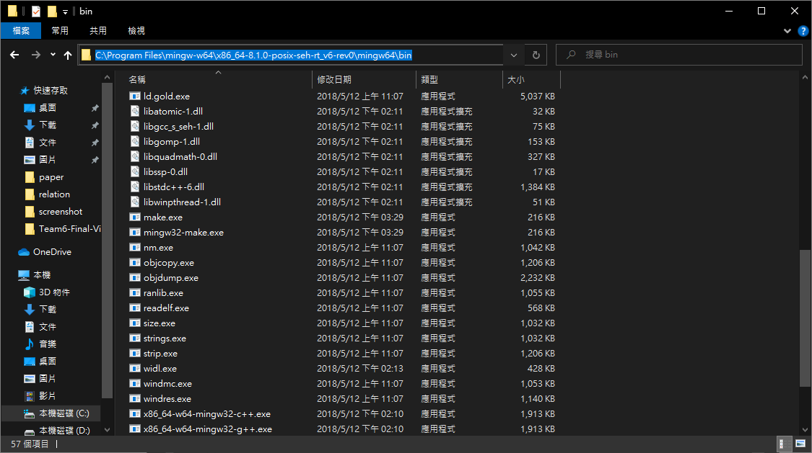
Copy the path of this folder

Slide 15
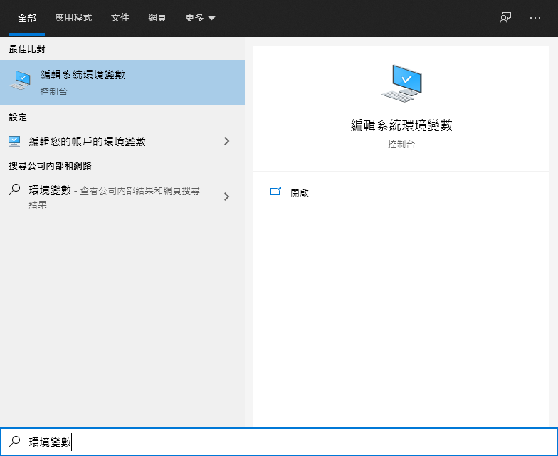
Search for environment variable

Slide 16
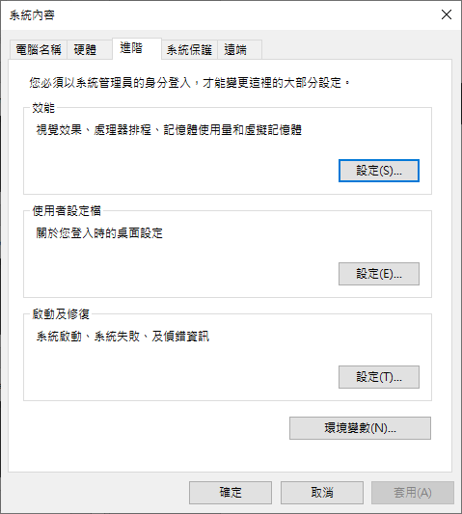
Click the “environment variable” button

Slide 17
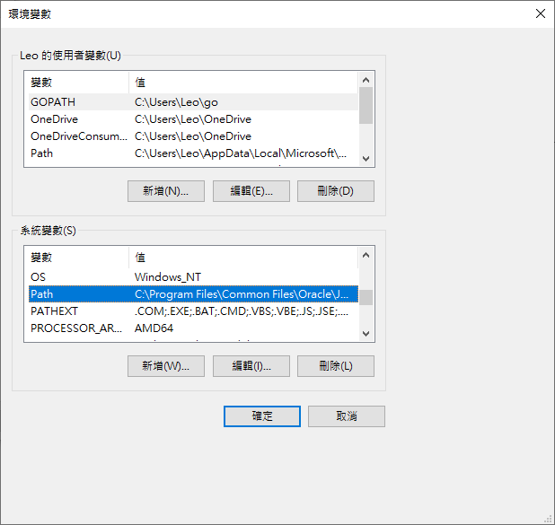
Double click “Path”

Slide 18
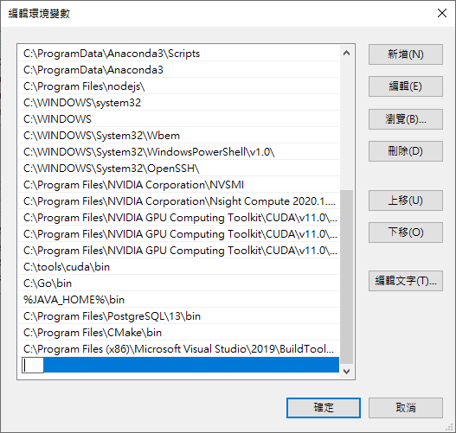
Click “New”

Slide 19
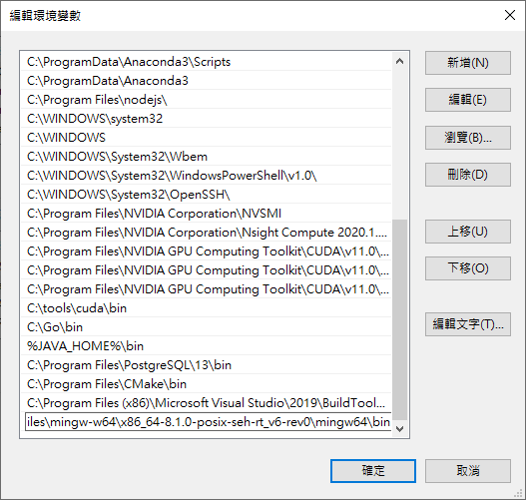
Paste the path and click “OK”

Slide 20
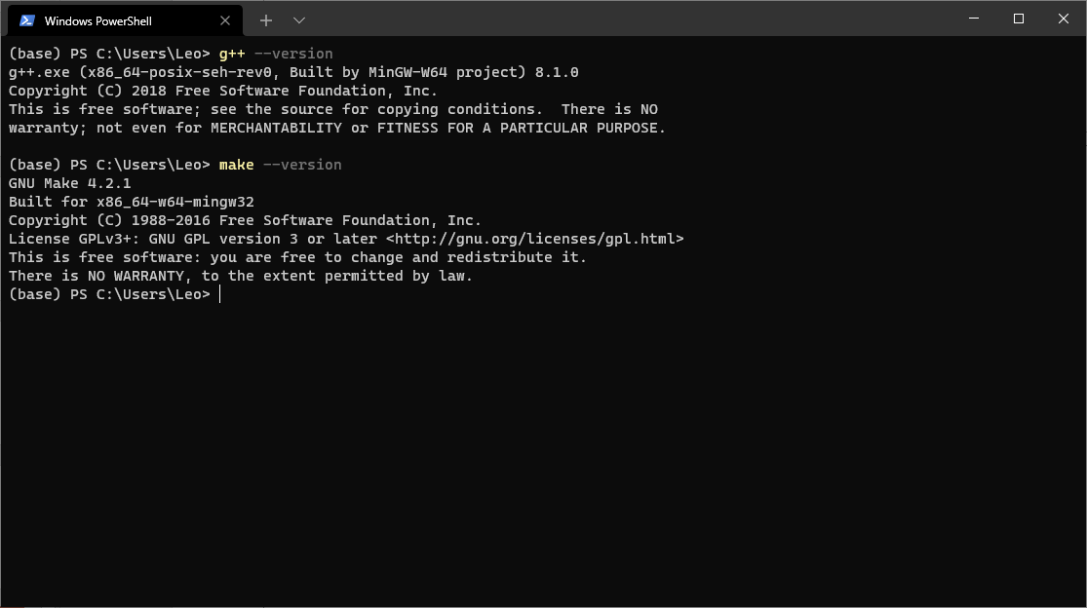
Open cmd or PowerShell to validate installation

Slide 21
For Windows Users
Install mingw-w64
Compile your code
Execute your code
Troubleshooting

Slide 22
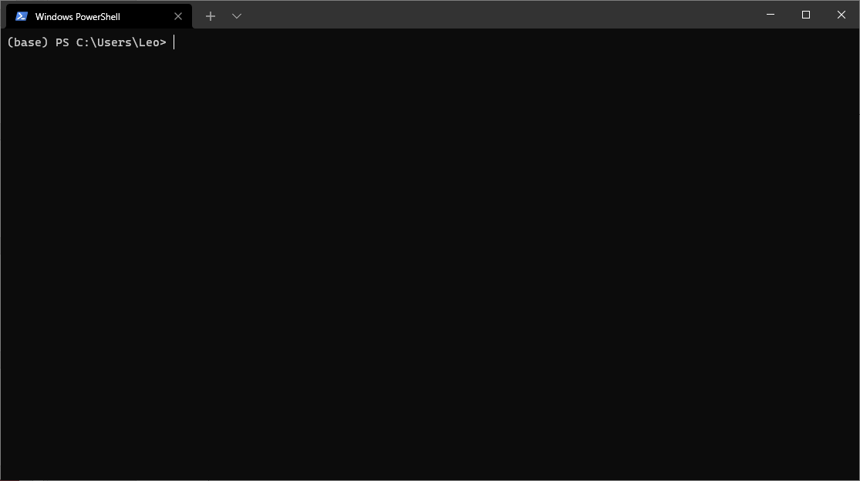
Open cmd or Powershell

Slide 23
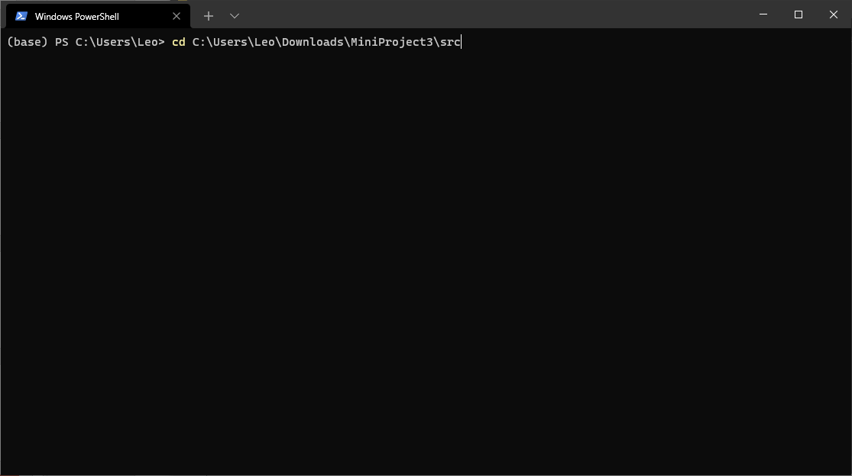
Change directory by entering “cd [project_path]/src”

Slide 24
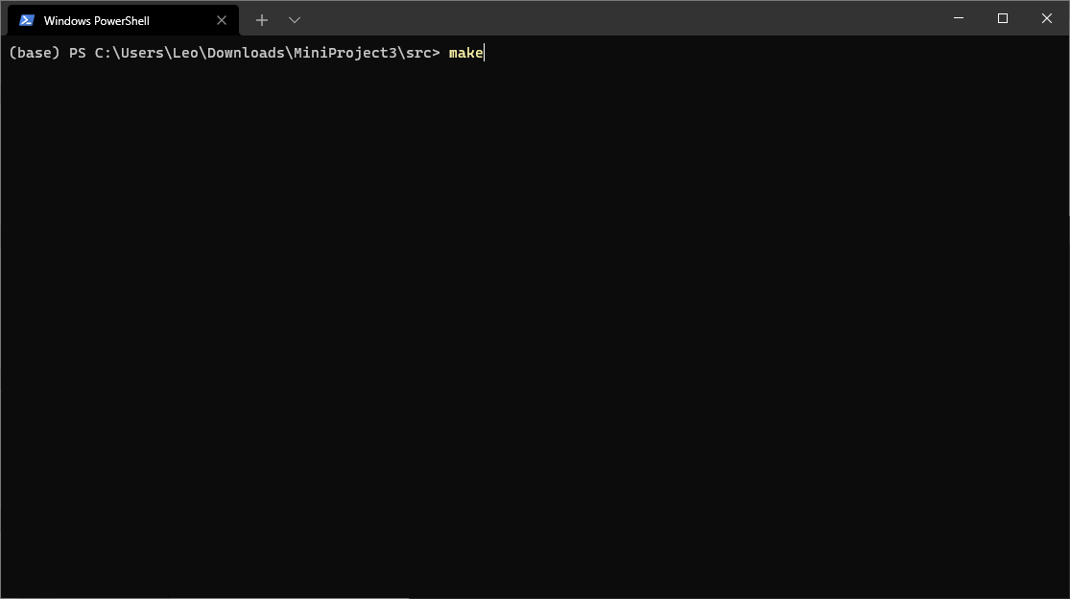
Type “make” to compile your code

Slide 25
For Windows Users
Install mingw-w64
Compile your code
Execute your code
Troubleshooting

Slide 26
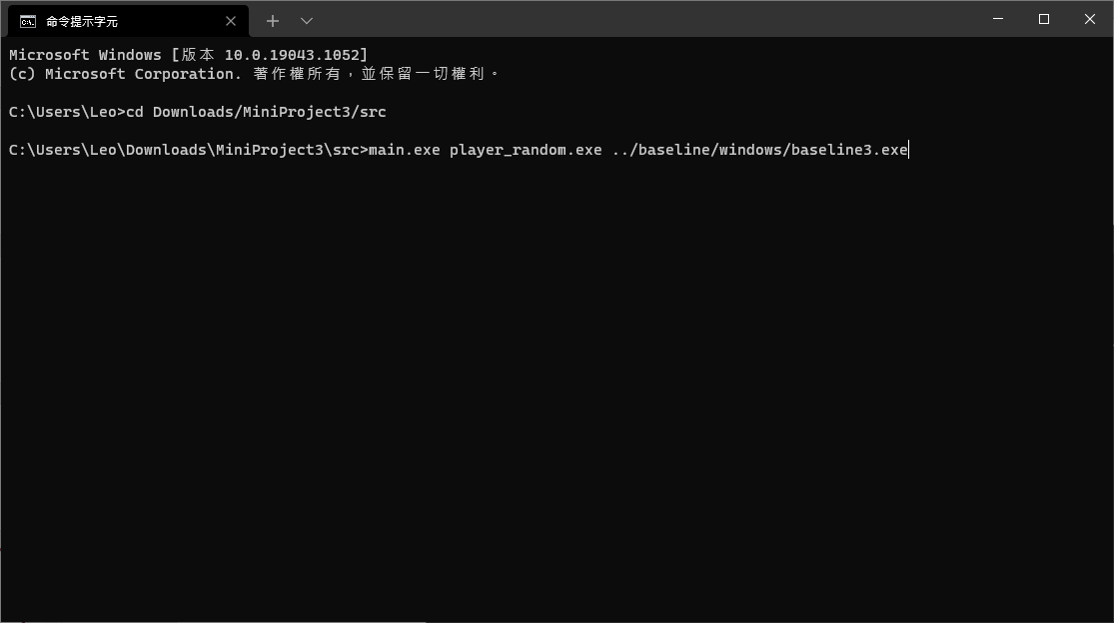
If you use cmd, type “main.exe [AI1].exe [AI2].exe” while in the “src” folder of your project

Slide 27
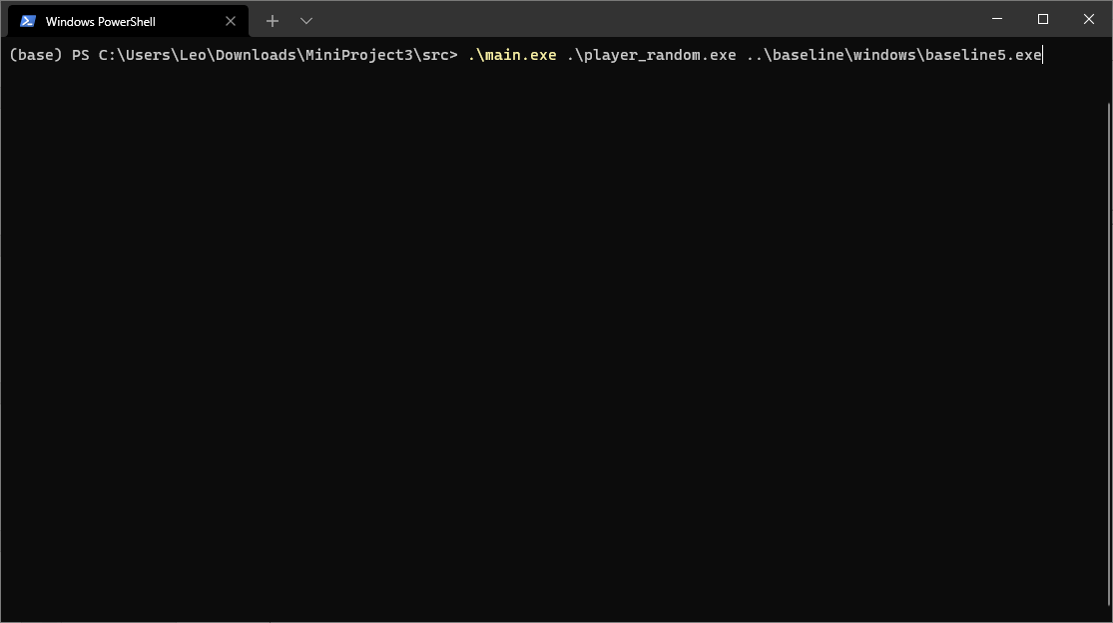
If you use PowerShell, type “.\main.exe [AI1].exe [AI2].exe” while in the “src” folder of your project

Slide 28
For Windows Users
Install mingw-w64
Compile your code
Execute your code
Troubleshooting

Slide 29
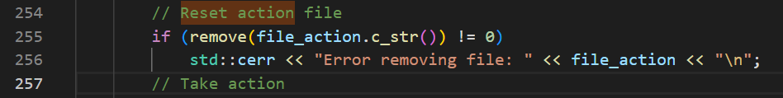
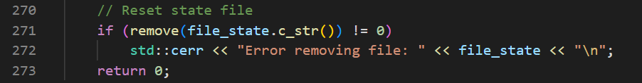
Error removing file: (state/action)
If you encounter this problem, do these steps and compile again
1. Comment line 255, 256 in main.cpp
2. Comment line 271, 272 in main.cpp

Slide 30
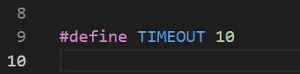
Error removing file: (state/action)
If the solution on the previous page still cannot solve the problem
You can try increasing the defined timeout limit on line 9 to 5 ~ 10
This might solve the problem

Slide 31
For Mac Users

Slide 32
For Mac Users
Install Homebrew
Install Coreutils
Modify file permissions
Compile your code
Execute your code

Slide 33
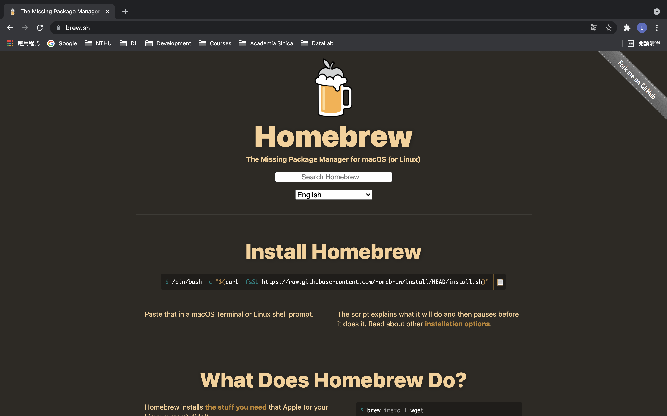
Go to Homebrew homepage

Slide 34
Copy the install command

Slide 35
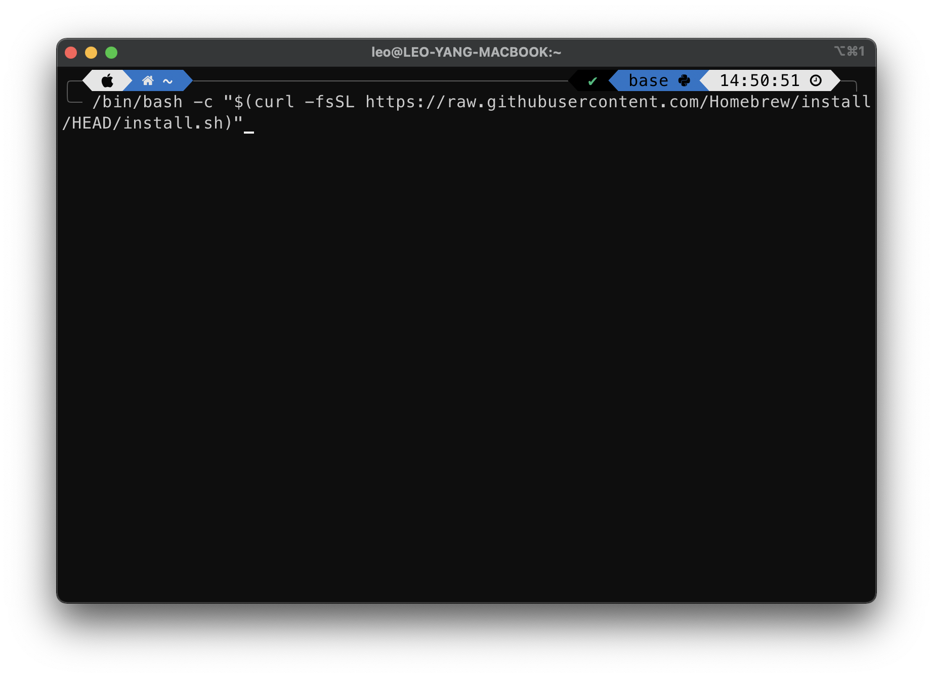
Paste the command in terminal and enter

Slide 36
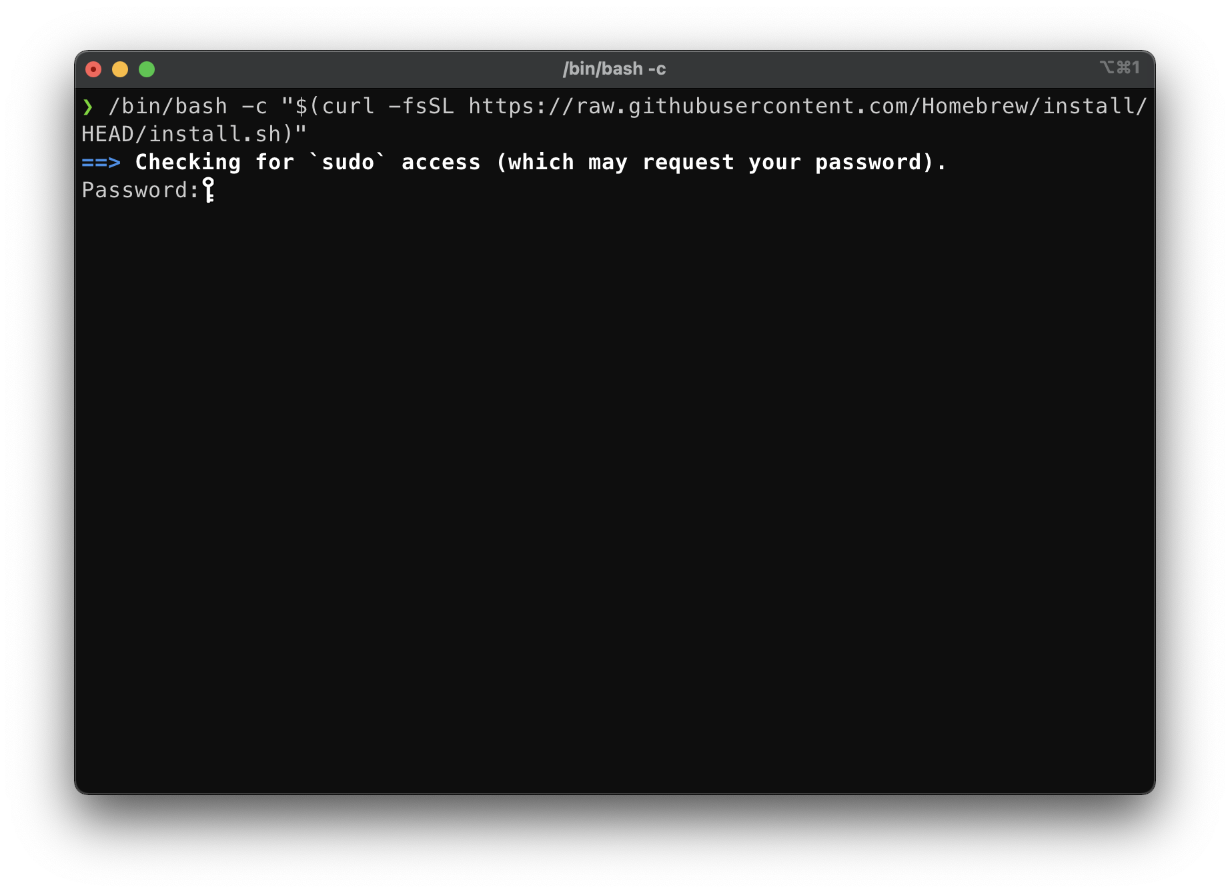
Enter your password

Slide 37
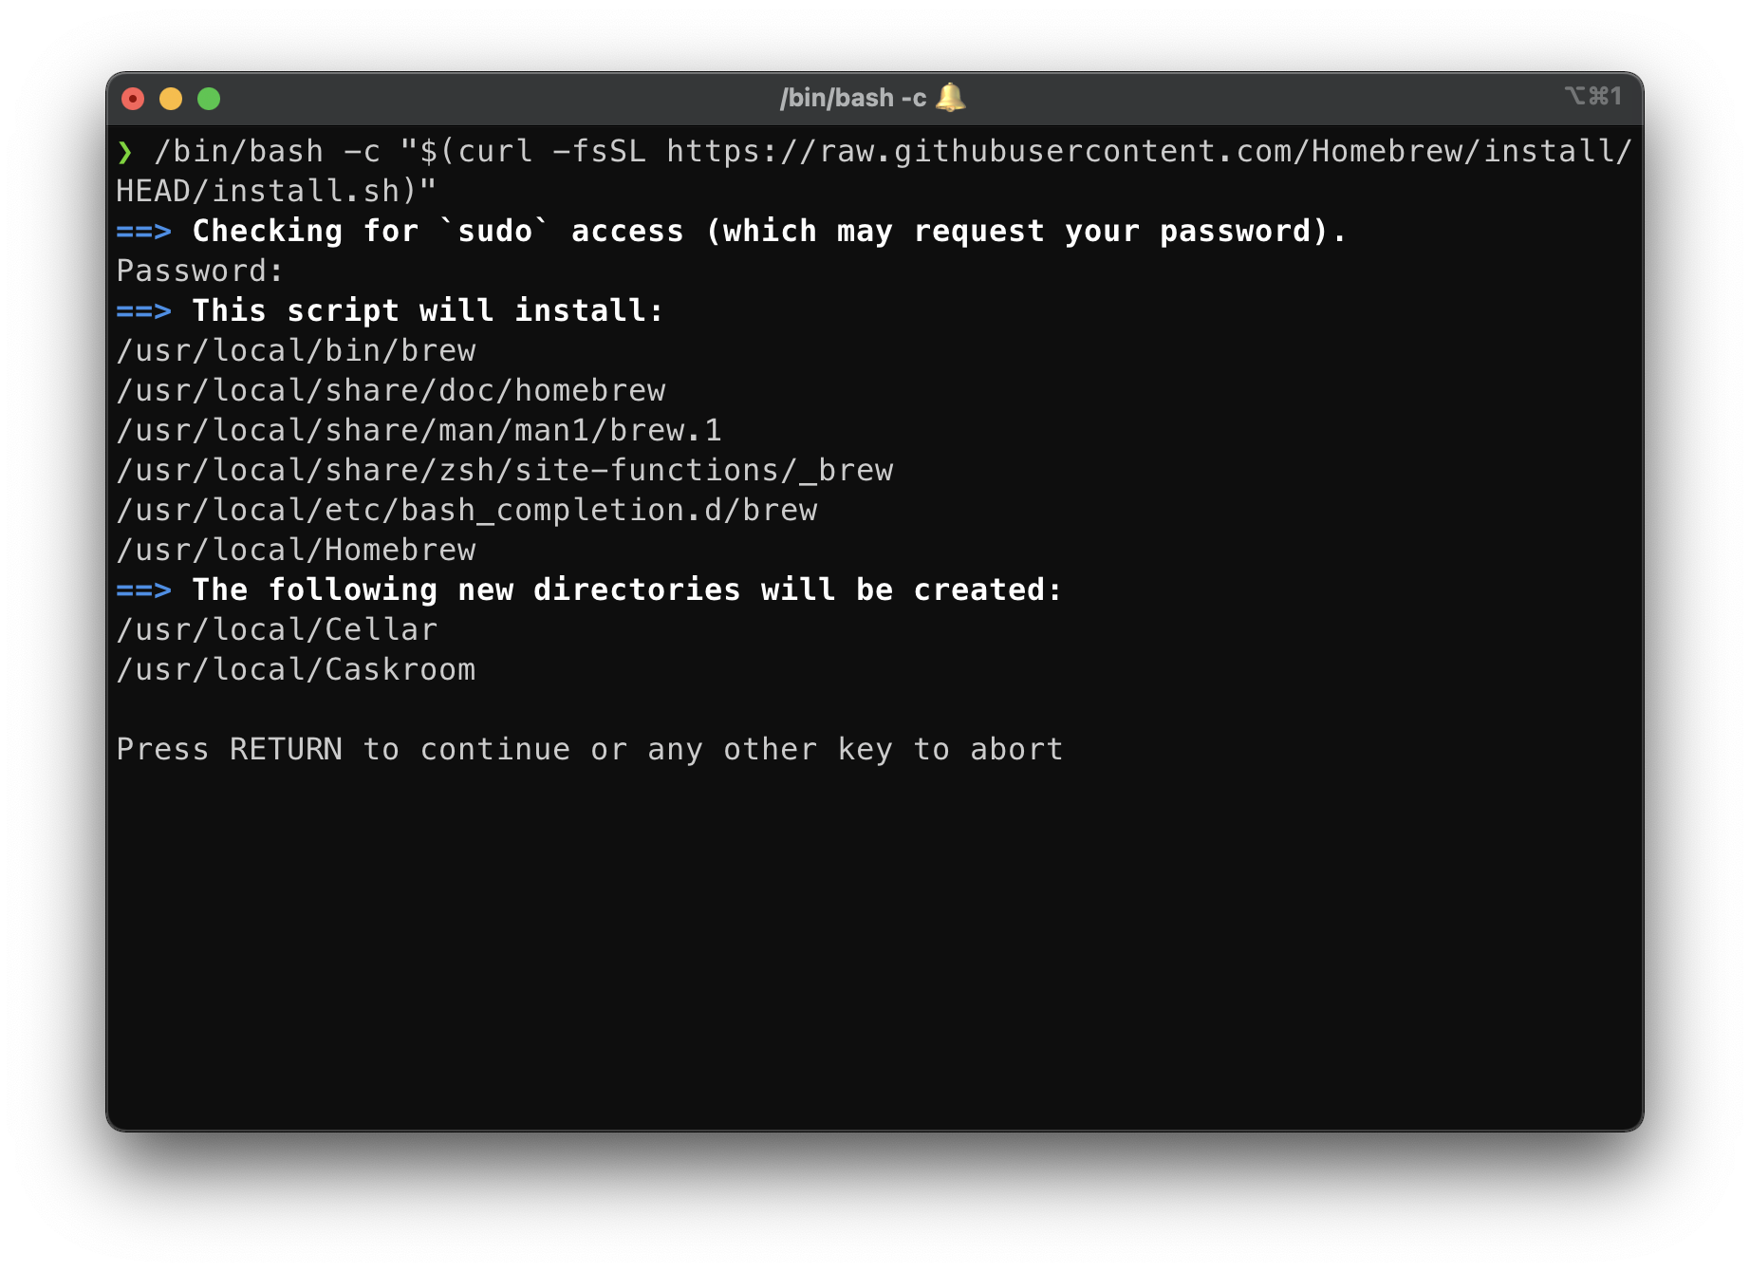
Press enter to install

Slide 38
For Mac Users
Install Homebrew
Install Coreutils
Modify file permissions
Compile your code
Execute your code

Slide 39
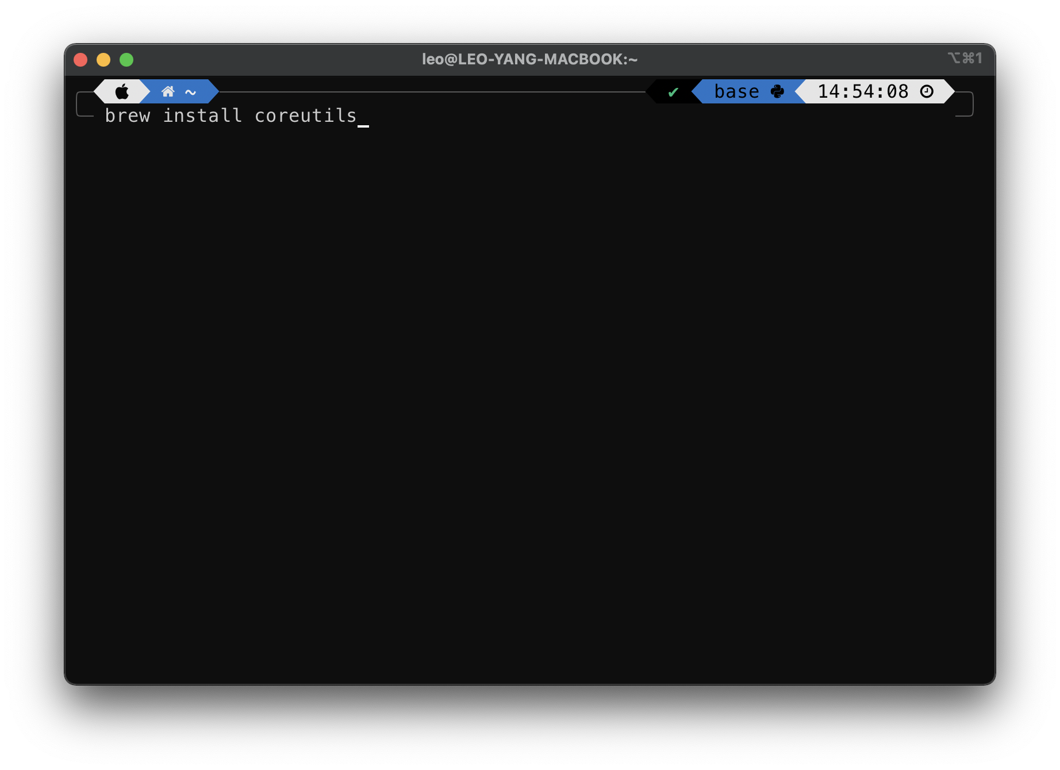
Type “brew install coreutils” in terminal

Slide 40
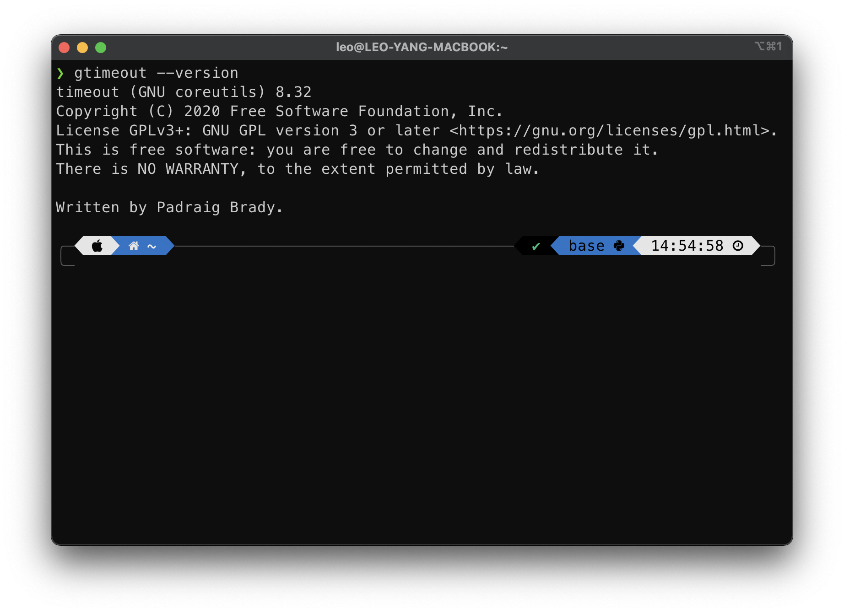
Type “gtimeout --version” to check if it works properly

Slide 41
For Mac Users
Install Homebrew
Install Coreutils
Modify file permissions
Compile your code
Execute your code

Slide 42
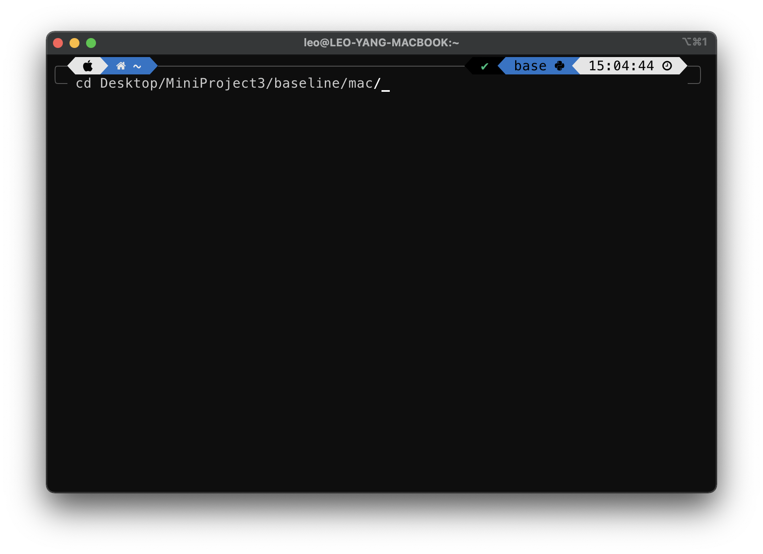
Change directory by entering “cd [project_path]/baseline/mac” in terminal

Slide 43
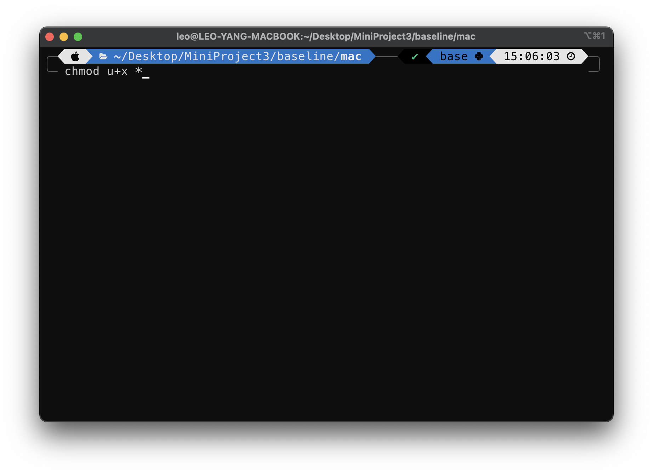
Type “chmod u+x *” in terminal to enable execution permission

Slide 44
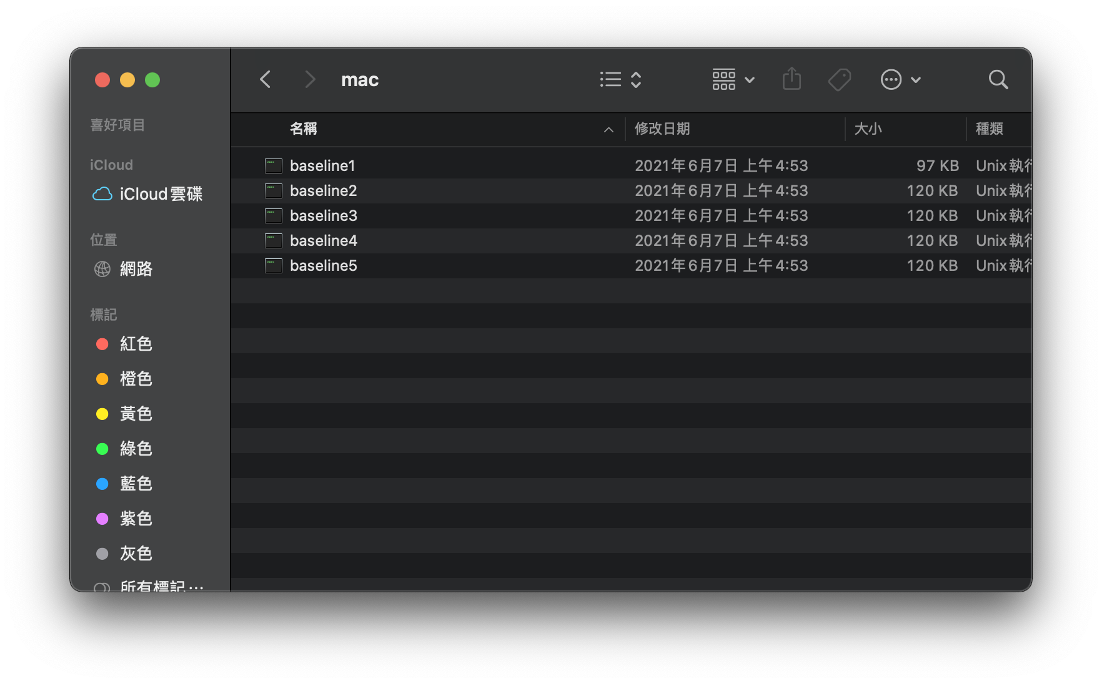
Open “[project_path]/baseline/mac” in Finder

Slide 45
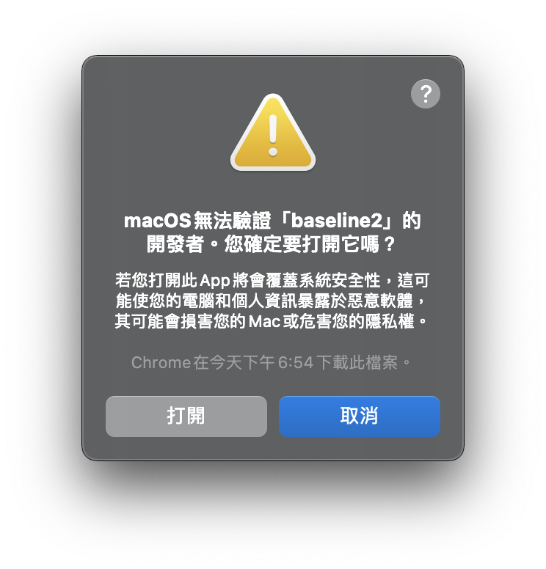
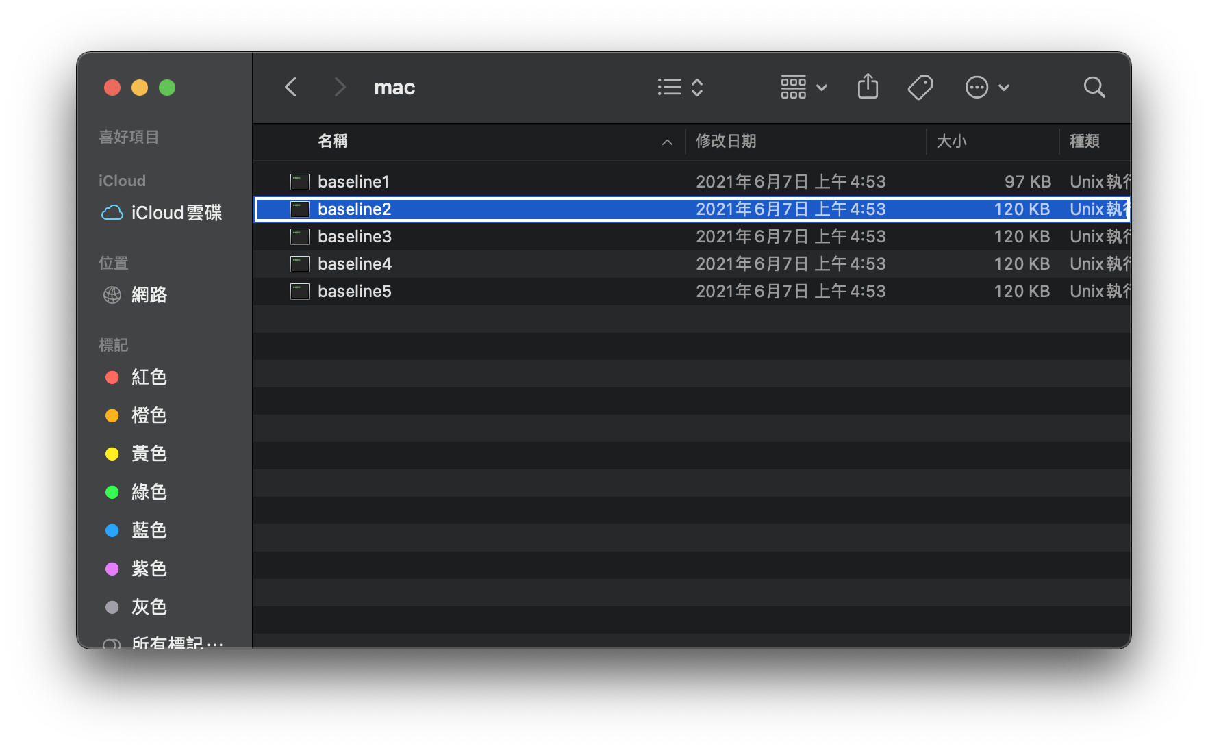
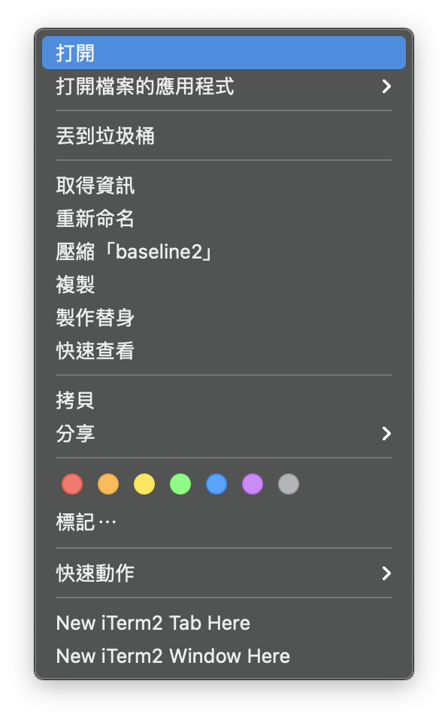
For all baselines, right click on the file and click “open”, then click “open” on the pop-up window

Slide 46
For Mac Users
Install Homebrew
Install Coreutils
Modify file permissions
Compile your code
Execute your code

Slide 47

Change directory by entering “cd [project_path]/src” in terminal

Slide 48
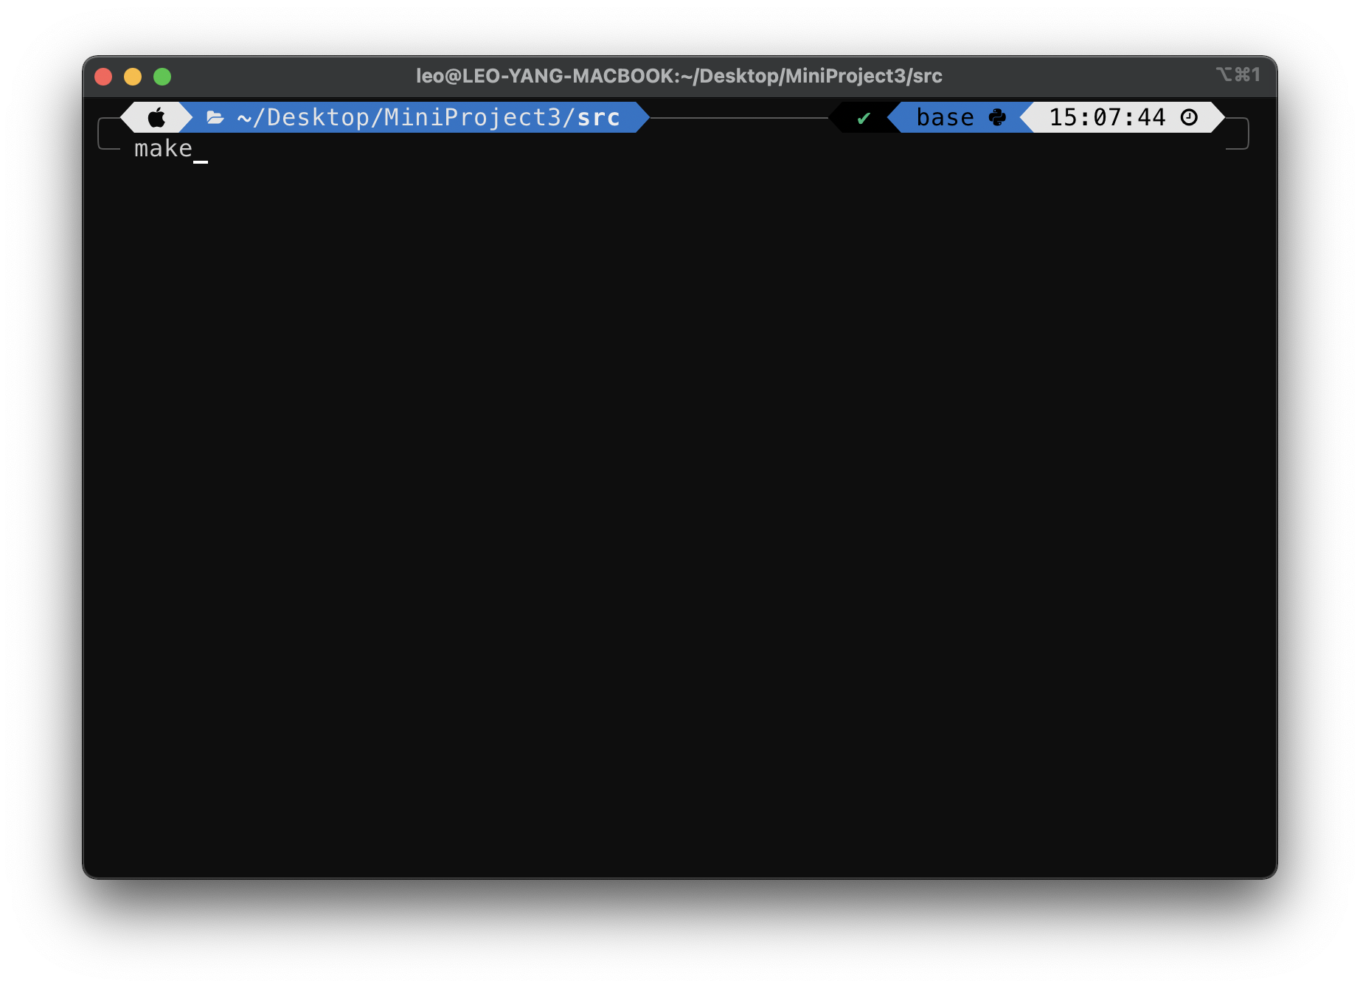
Type “make” to compile your code

Slide 49
For Mac Users
Install Homebrew
Install Coreutils
Modify file permissions
Compile your code
Execute your code

Slide 50
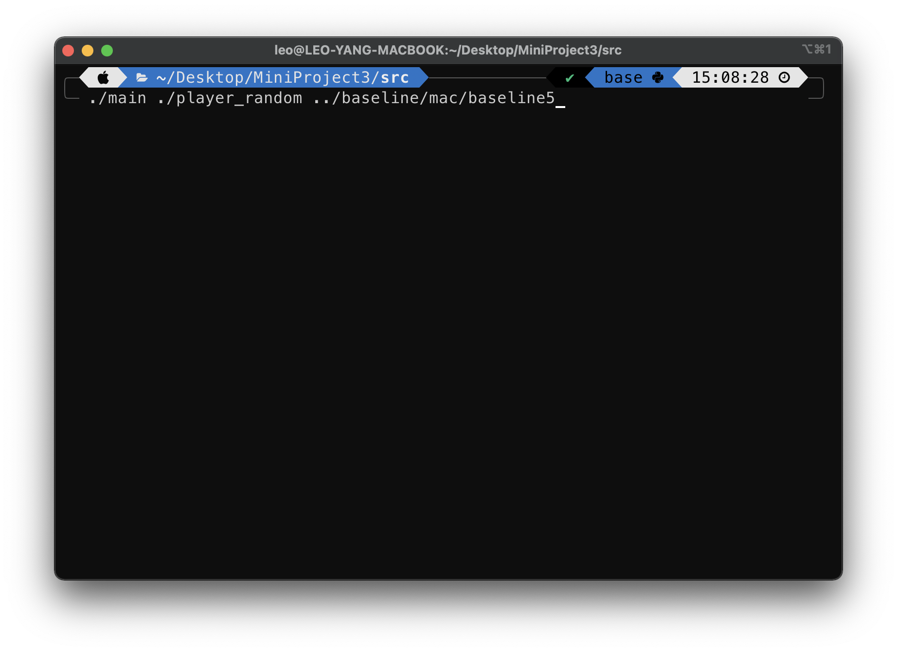
Type “./main ./[AI1] ./[AI2]” in terminal to execute while in the “src” folder of your project

Slide 51
Happy Coding!

